Slide 1


Find the Flowers
Notes:
This is a structured play activity to work on /f/ sounds in isolation via teletherapy, incorporating choices, word exposures, and movement breaks.
Developed by Youran Lin, BA, MA, MScSLP/PhD student at the University of Alberta.

Slide 2


Notes:
Funny bunny has a bundle of beautiful flowers. She wants to give them to Mommy.

Slide 3
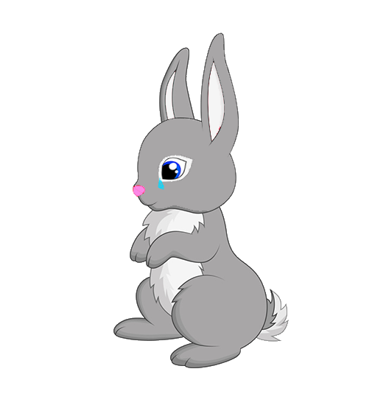
Notes:
But she lost the flowers… Now she’s feeling so sad. Let’s help funny bunny find the flowers!

Slide 4





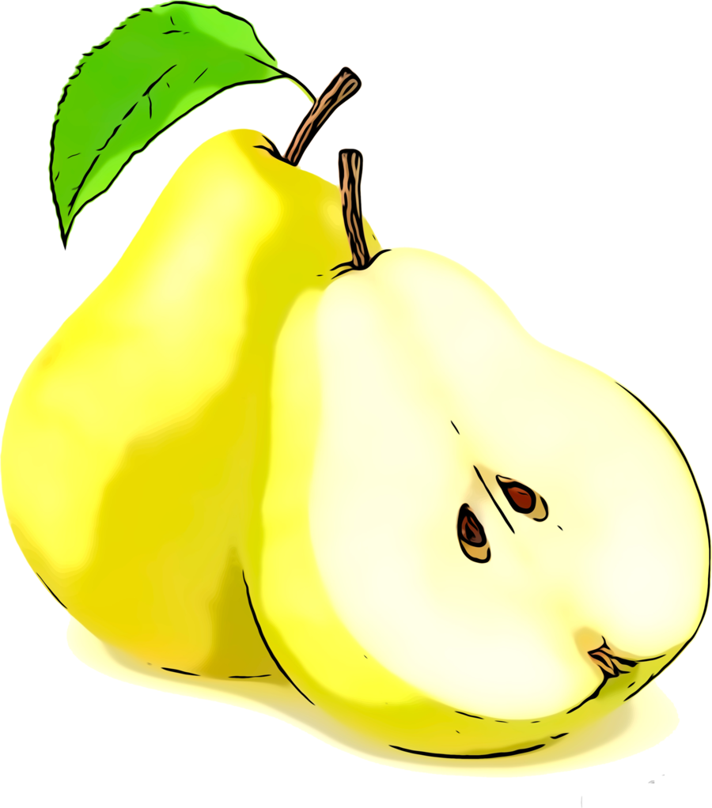
Notes:
Funny Bunny sets out to look for the flowers. She sees three bushes. The flowers must be under one of them!
But the bushes are so far away. Funny Bunny has to hop over there. [use the next 2 slides to demonstrate how to “hop” and “breathe”]
Mommy please use your big steps to measure where to start (2 steps, or let her choose).
Hop-and-breathe, until you can high-five with Mommy (or get close enough to the computer).
Look under a bush! Which one do you want to check?

Slide 5
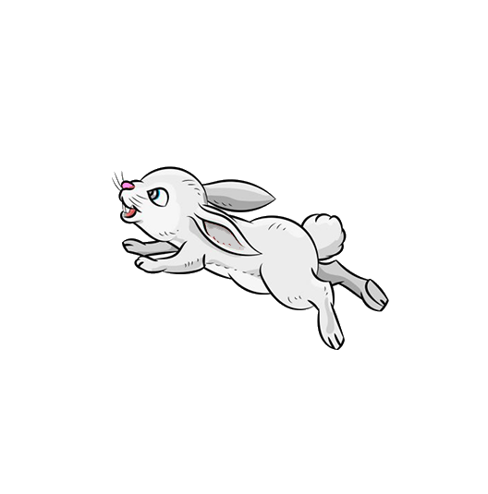
× 1
Notes:
From your starting point, hop!

Slide 6


× 3
Notes:
Each time you hop, you need to take a break and do the funny bunny breathing /f/.

Slide 7
Notes:
You helped funny bunny find her flowers! She gave them to Mommy. Now they are both so happy. Give each other a hug!

Slide 8
The End

